Slide 1


COVID-19 Twitter
Sentiment Analysis
Christopher Bach
Khalid Hamid Fallous
Jay Hirpara
Jing Tang
Graham Thomas
David Wetherhold

Slide 2
Current State

Slide 3
Covid-19 Sentiment Analysis: Current State
Twitter Covid-19 Sentiment Analysis
Reason topic was selected
Description of the source of data
Questions the team hopes to answer with the data
Description of the data exploration phase of the project
Description of the analysis phase of the project

Slide 4
Twitter COVID-19 Sentiment Analysis
This project aims to collect data from Twitter and perform sentiment analysis surrounding COVID-19 vaccines. We will perform the ETL using python and a SQL database, and also come up with some machine learning algorithms to possibly predict trends related to the virus and it's vaccines. The project will bring some meaningful discussions whether getting vaccinated stands in the way of individual personal liberty, including, but not limited to, the topic of employers requirement to have staff vaccinated. This project ultimately will be able to identify any correlation between changes in daily inoculation rates and changes in twitter sentiment surrounding COVID-19.

Slide 5
Why did we choose Twitter COVID-19 Sentiment Analysis?
We chose this topic because it is quite topical and has immediate importance to our lives and directly connects to current events.
We also believed that the topic would provide answers to actual questions in regards to how sentiment can be captured in regards to COVID-19.
Our topic also involves technology that is directly relevant to data analysis in the modern world

Slide 6
Our Source Data
Twitter.com - We used the Twitter API to gain access to tweets (limited to the past 7 days)
Kaggle.com - We supplemented Twitter API tweets with aggregated tweets from Kaggle (dating back to Dec. 2020)
CDC.gov - CDC data allowed us to access inoculation numbers and rates as well as Covid-19 cases and deaths

Slide 7
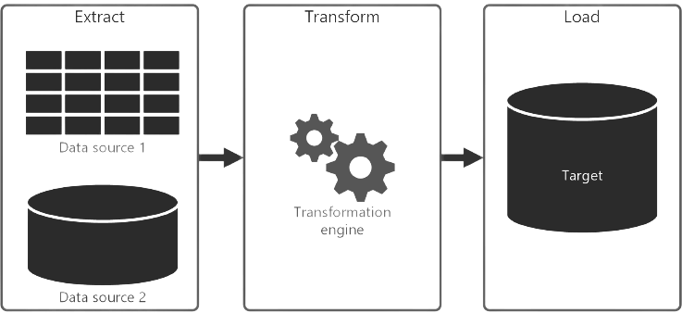


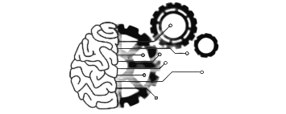

Python
ETL
Database
Machine Learning Algorithms
Notes:
our thinking is to get the polarity and subjectivity of tweets within certain time range and cross reference with cdc data. Chris said he had join two dataset by date, but his regression was really low. Ultimately, we’ll need to plot the sentiment by date with the twitter data, and join with our vaccination rate by date plot.

Slide 8
Questions Upon Further Analysis
Is there any correlation between tweet sentiment and vaccination rates?
If there is a correlation, can we use tweets to predict how vaccines can be distributed/marketed?
Notes:
our thinking is to get the polarity and subjectivity of tweets within certain time range and cross reference with cdc data. Chris said he had join two dataset by date, but his regression was really low. Ultimately, we’ll need to plot the sentiment by date with the twitter data, and join with our vaccination rate by date plot.

Slide 9
Sentiment Analysis:VADER vs. Textblob?
Vader is optimized for social media data and can yield good results when used with data from Twitter, Facebook, etc. As the above result shows the polarity of the word and their probabilities of being pos, neg, neu, and compound.
Textblob sentiment analyzer returns two properties for a given input sentence:
Polarity is a float that lies between [-1,1], -1 indicates negative sentiment and +1 indicates positive sentiment.
Subjectivity is also a float that lies in the range of [0,1]. Subjectivity sentences generally refer to opinion, emotion, or judgment.
Notes:
Split in-between 2 categories of questions: future (addressed upon further analysis) & present (what have we confirmed in the meantime)

Slide 10
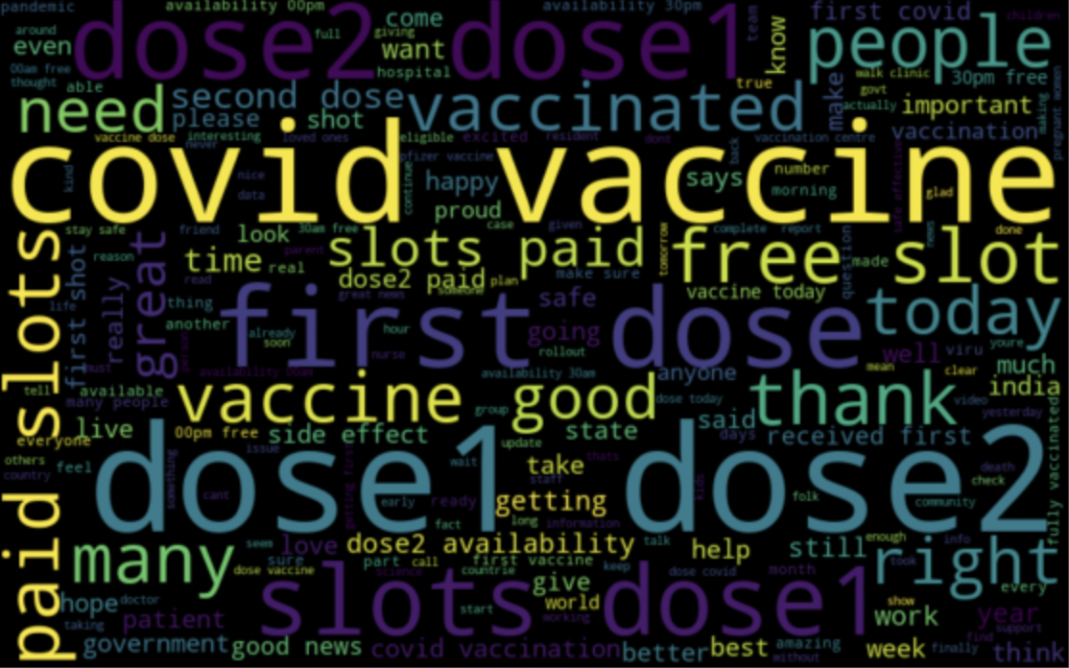
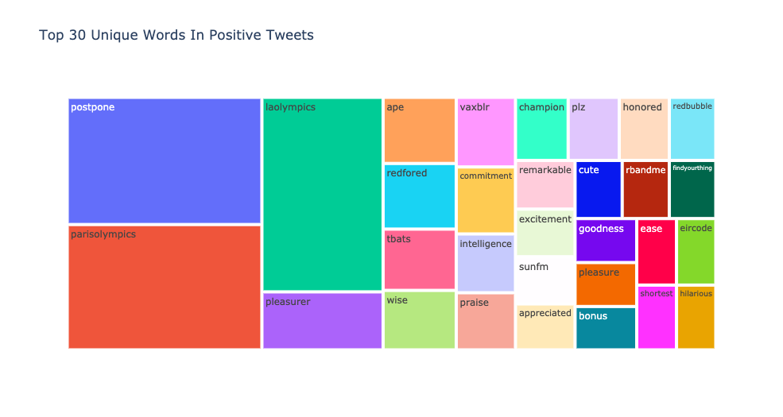
Data Exploration/Analysis/Visualization
What common words appear in our sentiment analysis?
Positive:
Textblob VADER
Notes:
Steps to produce analysis:
Load historical twitter covid vaccine data from kaggle.
Clean tweets with clean_tweet function(regex), tokenize and get ready for text classification. Also, clean up function for removing hashtags, URL's, mentions, and retweets.
Apply Textblob.sentiment.polarity and Textblob.sentiment.subjectivity, ready for sentiment analysis.
Apply analyze_sentiment function on tweet texts to label texts with sentiment range from -1 (negative) to 1(positve).
Plot top 10 words from postivie and negative-resulted words.

Slide 11
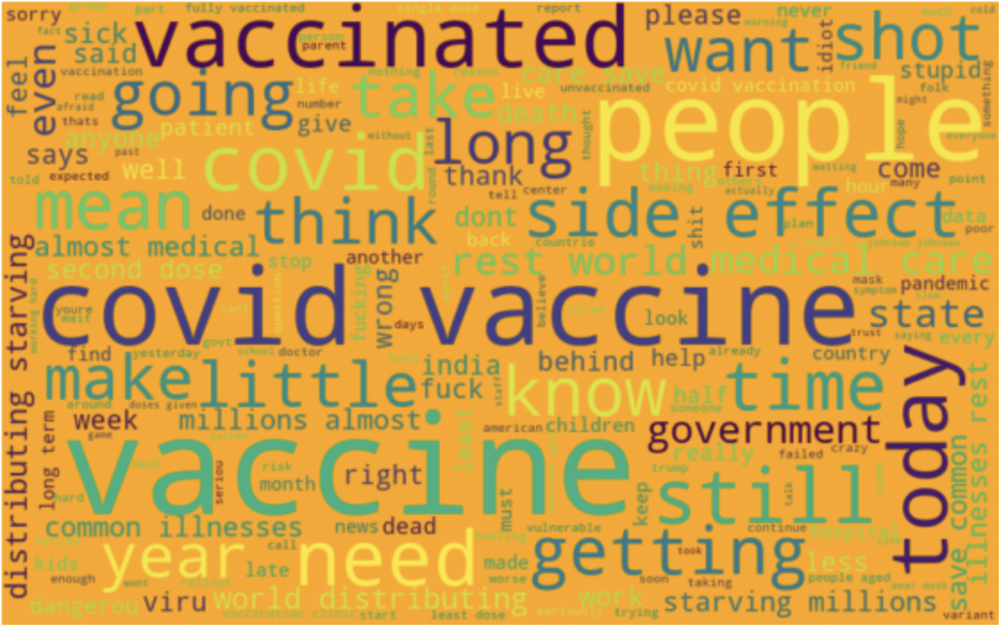
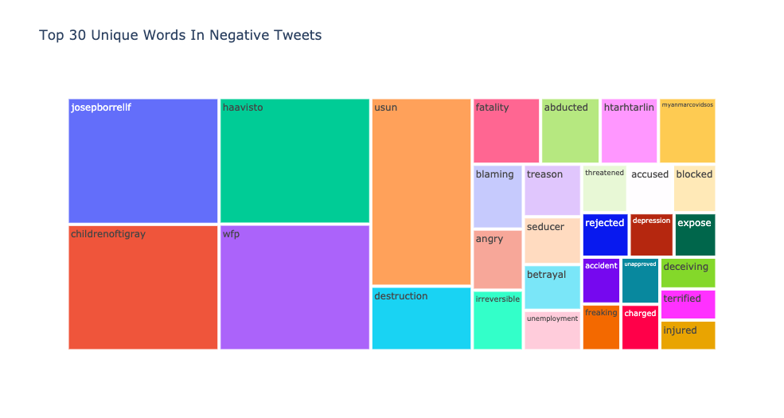
Data Exploration/Analysis/Visualization
What common words appear in our sentiment analysis?
Negative:
Textblob VADER
Notes:
Steps to produce analysis:
Apply Textblob.sentiment.polarity and Textblob.sentiment.subjectivity, ready for sentiment analysis.
Apply analyze_sentiment function on tweet texts to label texts with sentiment range from -1 (negative) to 1(positive).

Slide 12
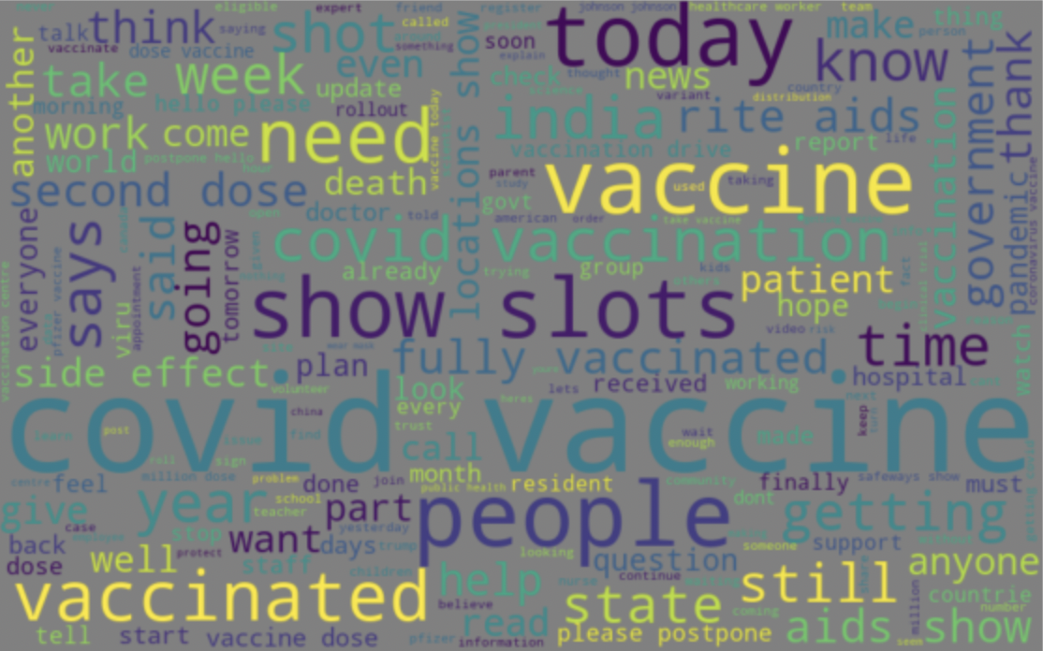
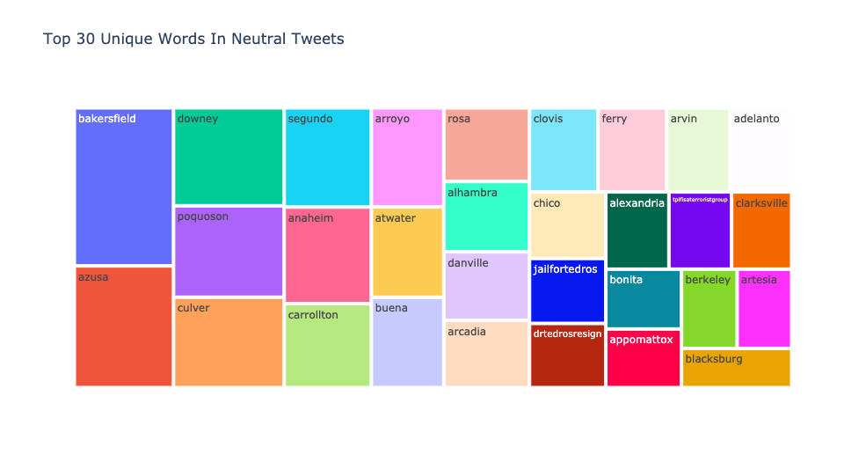
Data Exploration/Analysis/Visualization
What common words appear in our sentiment analysis?
Neutral:
Textblob VADER
Notes:
Steps to produce analysis:
Apply Textblob.sentiment.polarity and Textblob.sentiment.subjectivity, ready for sentiment analysis.
Apply analyze_sentiment function on tweet texts to label texts with sentiment range from -1 (negative) to 1(positive).

Slide 13
Data Exploration/Tableau
Notes:
It appears so, yes - analysis completed by downloading datasets from CDC and loading them into tableau where viz’s created (dashboards below:)
Jay: https://public.tableau.com/app/profile/jay.s.hirpara/viz/COVID-19Dashboard_16313779892960/COVID-19Dashboard?publish=yes
Graham: https://public.tableau.com/app/profile/graham.thomas4028/viz/Covid-19Data_16314587522250/CovidCasesvDeaths?publish=yes

Slide 14
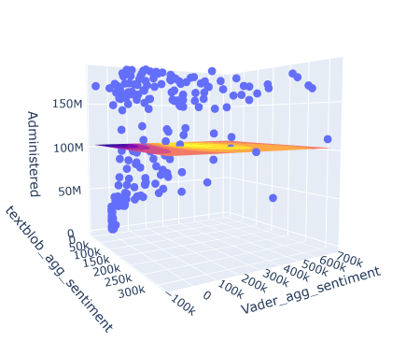
Regression Analysis (a)
Notes:
(cumulative) (Textblob/Vader) (reduced) (a)
R2 = .29
Textblob p = .932
Vader p = 0.000

Slide 15
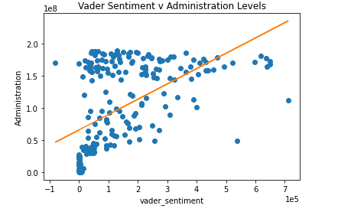
Regression Analysis (b)
Notes:
(cumulative) ( Vader) (reduced) (b)
R2 = .29
Vader p=0

Slide 16
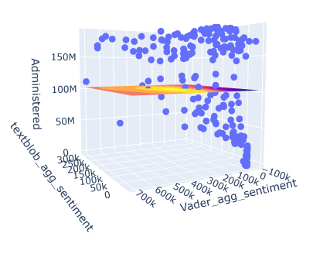
Regression Analysis (d)
Notes:
R2 = .003
P textblob = .54
P vader = .45

Slide 17
Challenges and Limitations
Facebook, Instagram and TikTok were all considered initially, but did not have the necessary data readily available.
Some members ran into issues with gaining Academic Twitter accounts to be able to access the Twitter API.
After gaining access to tweets our original goal of using the location of tweets was not possible due to most tweets not having geotag data
The Twitter API was very limited to the amount of data we could pull
Using academic accounts only allows access back to 7 days of tweets. We could not get twitter's full archive search without having a twitter scholar account.
The group decided to use a Kaggle Dataset, which provided us with thousands of tweets from December 20, 2020 when the first vaccine was announced.
Group ran into a machine learning natural language paradox, where we noticed an issue within our sentiment analysis. When analyzing tweets for Covid-19 Vaccination sentiment (pro/anti-vaccine) when running into a tweet such as “I hate anti-vaxxers”, this would return a negative sentiment when this person is actually pro-vaccine.
Notes:
Solution to limitations: We discovered the most common words appeared in our twitter dataset are associated with covid vaccines because we retrieved the data with covid vaccine as search terms. Textblob Polarity is float which lies in the range of [-1,1] where 1 means positive statement and -1 means a negative statement. Subjective sentences generally refer to personal opinion, emotion or judgment whereas objective refers to factual information. Subjectivity is also a float which lies in the range of [0,1]. We are trying to process text classification with another function to get more accurate sentiment labels on the tweet texts.

Slide 18
Questions?
?
?
?
?
?
?
?
?
?
?
?
?
?
?
?
?
?
?
?
?
?
?
?
?
?
?
?
?
Notes:
our thinking is to get the polarity and subjectivity of tweets within certain time range and cross reference with cdc data. Chris said he had join two dataset by date, but his regression was really low. Ultimately, we’ll need to plot the sentiment by date with the twitter data, and join with our vaccination rate by date plot.

